Slide 1

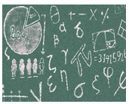




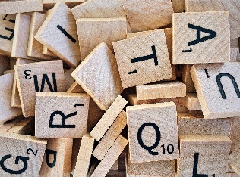
English
Year 2
Learning Overview
Spring 1
Maths
In English this half-term, the children will be focusing on the story of ‘ Hansel and Gretel’. They will revise the different skills used in Year 2 such as: tense, using a coma in writing, conjunctions, expanded noun phrases when studying the story.
In Maths this half-term, the children will be studying division and fractions. They will start by sharing concrete objects equally between groups and then move on to dividing numbers.
Fraction – the children will look at ½ of objects and amounts, then ¼ of objects and amounts and finally 1/3 of objects and amounts.
Suggestions of ways you can support your child’s English: Write sentences with different forms: statement, question, exclamation, command. Use punctuation ? ! . , within writing.
Trips and Experiences
SAVE THE DATE!
Science week
^{9th – 13th} March
Suggestions of ways you can support your child’s Maths: Check understanding of ‘÷’ and ‘=‘ symbol. Talk about sharing equally with amounts.
Science
Topic
This term we will be completing our science in one week. This will be our whole school science week on 9th- 13th
March. We will be investigating ‘Curiosity’ Our big question is ‘If we can grow our own food, why do people in the world go hungry?’
This half-term we will be focusing on both Geography and History. We are continuing to learn about ‘The Three Queens’ Queen Elizabeth I, Queen Victoria and Queen Elizabeth II. We will be find out about where in the world they reigned and significant people who were alive in the different time periods.
Extra Information
P.E: PE will continue to be on Tuesday and Thursday.
Water Bottle: Please send children in with a reusable bottle or a shop brought bottle. Label with child's name. Only water please.
Merits: Merits are awarded for behaviour, reading and homework. Reading records must be in school everyday.
Homework: Homework is set on Google Classroom every Friday. Homework is due on Wednesday morning.
Spellings are set on Google Classroom every Friday. Spelling test will be the following Friday.

