Slide 1
Eco warrior update!
December 2018

Slide 2
Your Eco-Warriors (KS1)
1K- Finley Purcell
1M- Scott Herd
2T- Nathan Mifsud
2JV- Riley Allen

Slide 3
Your Eco-Warriors! (KS2)
3N- Kasparas Zackeras
3M- Isabel Mwanza
3B- Ira Kaur
4C- Harley Armstrong
4H- Demi Day
4S- Beth Elliot

Slide 4
Your Eco-Warriors! (KS2)
6N- Lana Mifsud
6K- Itunnu Adewa-Faboro
5W- Freddie Day
5B- Yusuf Flynn

Slide 5
What are the Eco Warriors doing?
Last year, we earned the Bronze eco-schools award!
We are now working towards earning the Silver award.
To do this we need to show that we learn about the environment and continue to improve our school grounds.

Slide 6
We have been working on our ‘Waste’ topic…

Slide 7
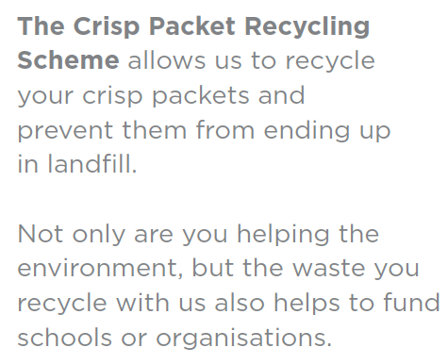
We have been working on our ‘Waste’ topic…
All you need to do is…
Wash out your crisp packets (any brand)
Let them dry
Bring them to school!

Slide 8
Some extra information:

Slide 9
If you would like to know more about what happens to the crisp packets once we have sent them off, please watch this video!
https://www.walkers.co.uk/recycle

Slide 10
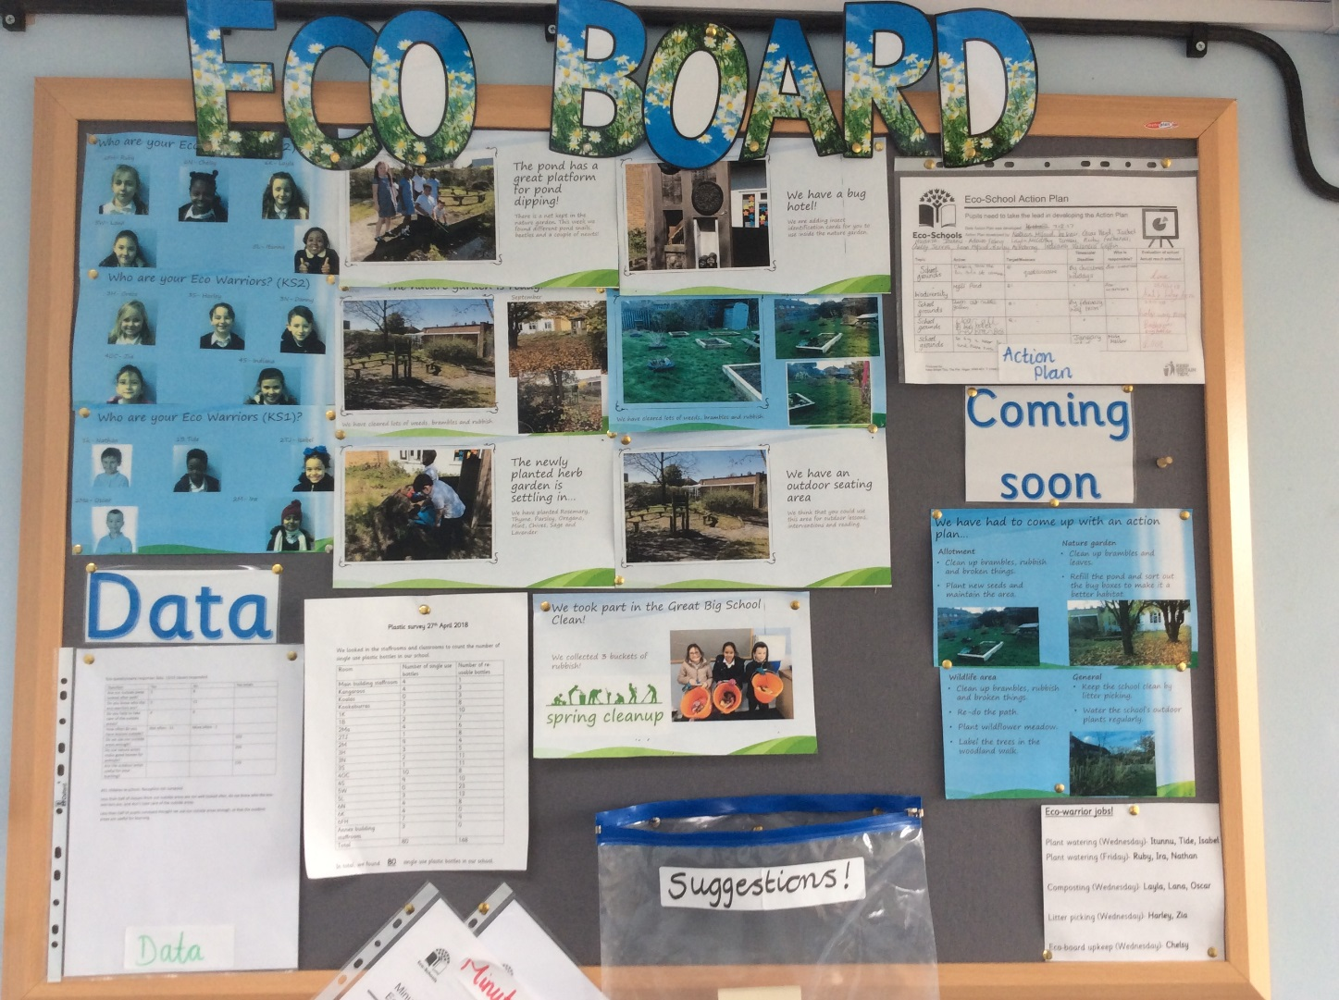
If you want to know more, check the eco-board!
This is in the first aid area in the main building.
There is also a suggestions box with post-it notes and a pencil if you have any ideas that you think the eco-committee should consider.

Slide 11
We will update you again soon!
Please help us to keep the school grounds tidy!

